Slide 1
Division of Biological Infrastructure NEON Competition Webinar
Roland P. Roberts
Program Officer: NEON Operations, BIO/DBI
September 11, 2019

Slide 2
Overview
1. Project intent and design
2. NEON data themes and data products
3. NEON Subsystems
4. NEON operational requirements
5. NEON competition DCL
6. NSF’s oversight of Large Facilities
7. Questions

Slide 3
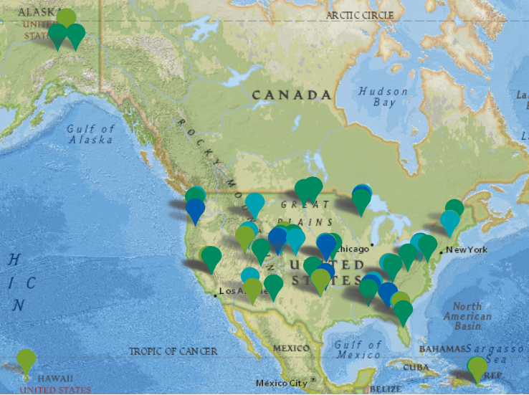
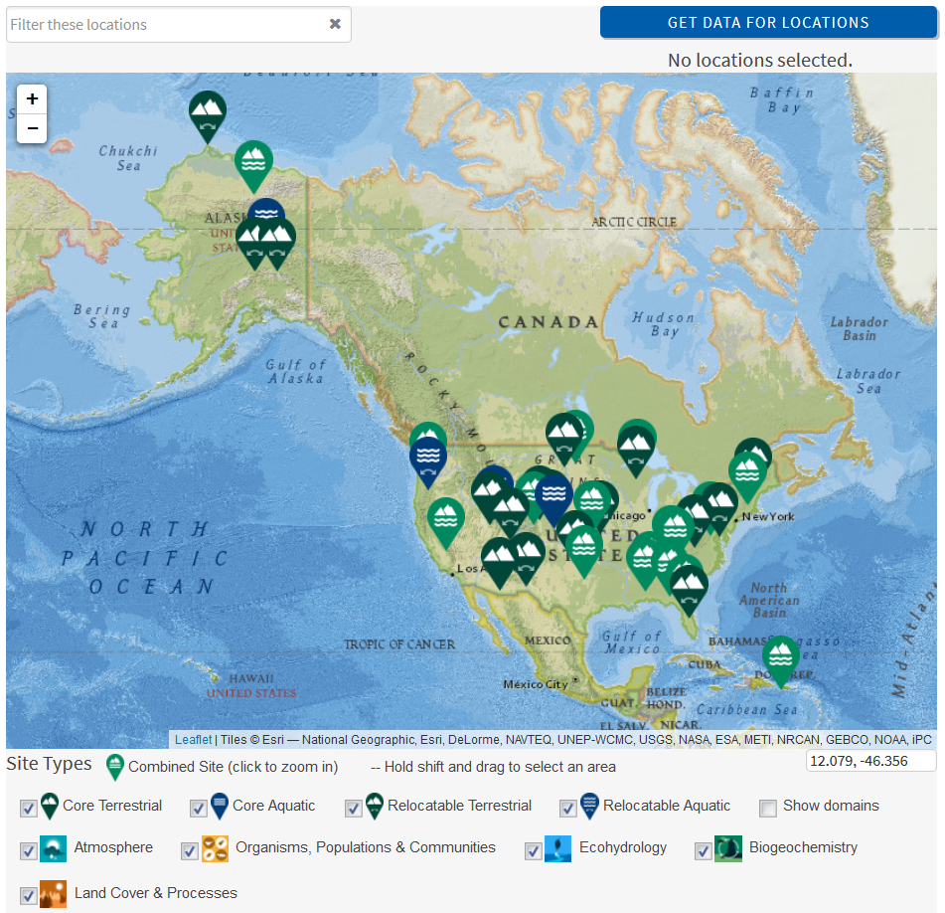
NEON: Intent
Enable regional- to continental-scale research
30-year lifespan to explore decadal trends
Enable individual and team science
Democratize and standardize ecological research

Slide 4
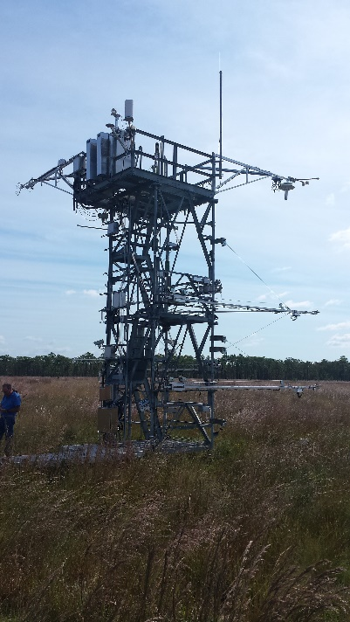
NEON: Design
Geographically distributed field and lab infrastructure
Fully networked research platforms
Internet accessible, data, computational, analytical, and modeling capabilities

Slide 5
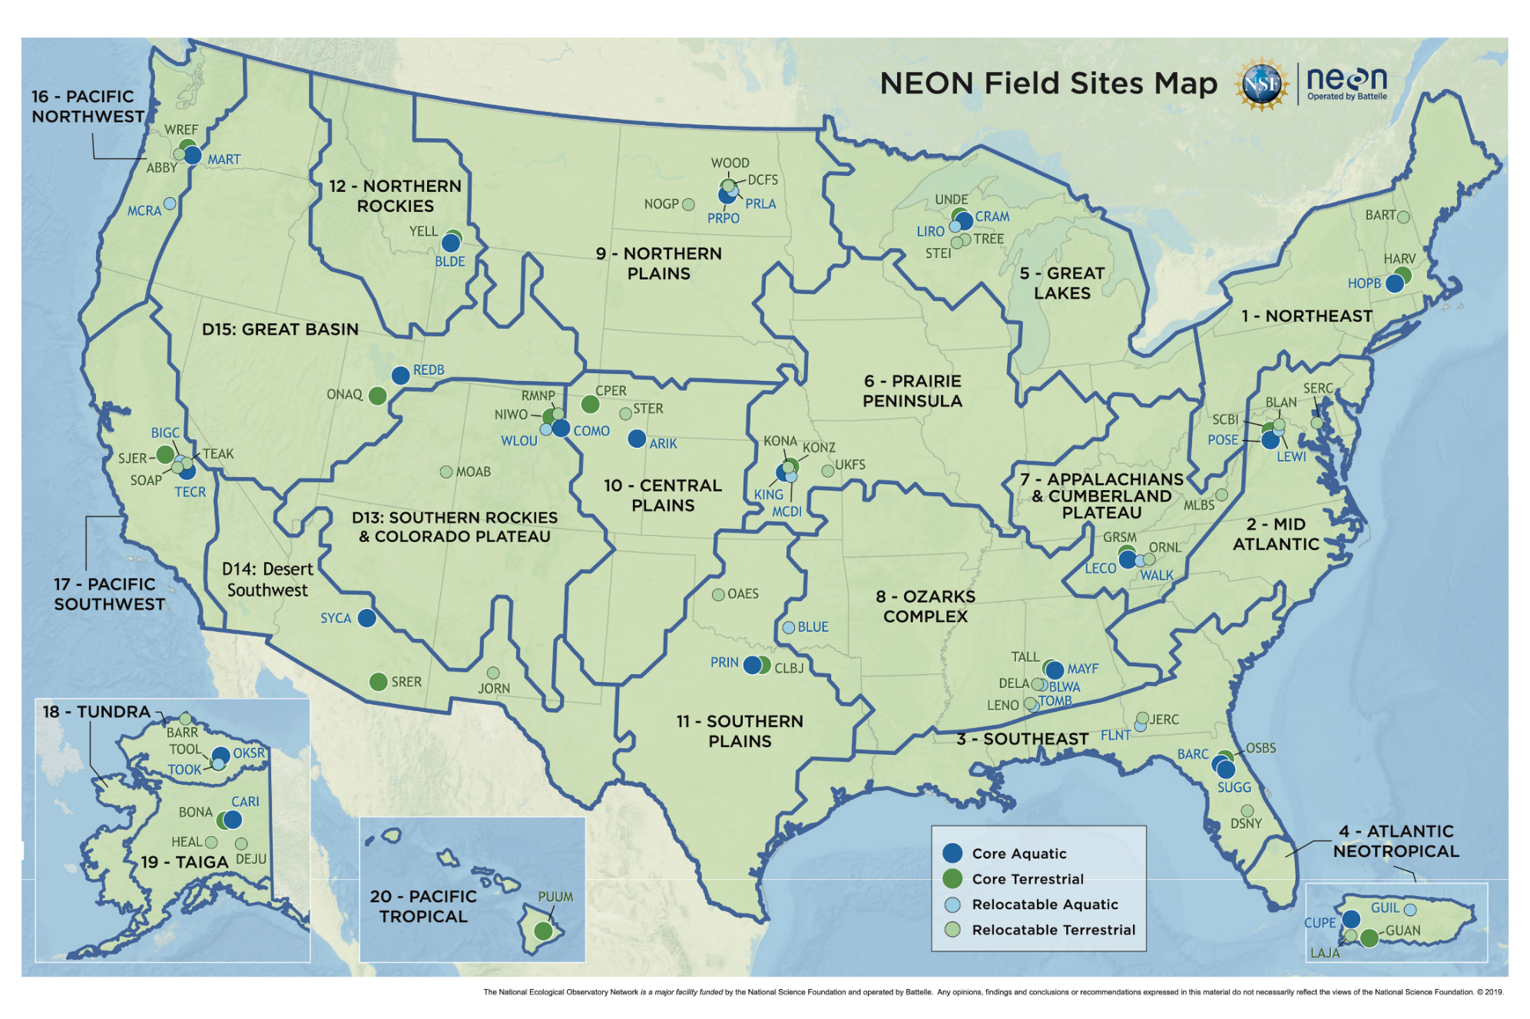
NEON: Locations and Domains
www.neonscience.org
Notes:
34 Aquatic Sites
47 Terrestrial Sites
All with instrument and observational sampling.
Standardized methods deployed across sites

Slide 6
NEON: Data themes and Data products
Five Data Themes
Atmosphere
Biogeochemistry
Ecohydrology
Land Cover and Processes
Organisms, Populations and Communities
179 Data Products

Slide 7
NEON: Subsystems
Terrestrial and Aquatic Instrument Systems (TIS & AIS)
Meteorology
Phenocams
Soil Sensors
Surface Water
Groundwater
Surface Air Exchange
Terrestrial & Aquatic Observation Systems (TOS & AOS)
Aquatic Organisms
Terrestrial Organisms
Soils and Sediments
DNA Sequences
Biogeochemical
Geomorphology
Pathogens
Airborne Observation Platform (AOP)
Lidar data
Hyperspectral data
High resolution camera
Biorepository
Assignable Assets
Airborne Observation Platform (AOP)
Mobile Deployment Platforms (MDP)
Access to sensor infrastructure
Access to observational sampling infrastructure

Slide 8
NEON: Operations
Resource requirements
Data acquisition
Data QA/QC
Data dissemination
Cyberinfrastructure
Human resource management
At peak, over 500 employees
Permanent
Seasonal
Engagement and Outreach
Advisory bodies; strategic, science and technical
Engage with scientific community
Education and training

Slide 9
NEON Competition*
Rationale for competition
Normal NSF process for large facilities
Competition timeline: key target dates
Submission of comments and questions, September 30, 2019
Solicitation, coming fall 2019
Letter of intent, anticipated
Full proposals due, June 2020
Potential award start date, anticipated late 2021
* Information provided in the Dear Colleague Letter (NSF 19-080)

Slide 10
NSF’s Oversight of Large Facilities
Award oversight mechanism: Cooperative Agreement (CA)
Unique attribute of CAs
Substantial involvement and interaction between NSF and the grantee in carrying out the activity contemplated award.
CAs are living documents that are agreed upon and amended by NSF and Awardee.

Slide 11
Summary
Enabling predictive, regional- to continental- scale research
Complex distributed infrastructure; complex subsystems, large number of employees and numerous requirements
Competition key dates
NSF’s Oversight of NEON

Slide 12
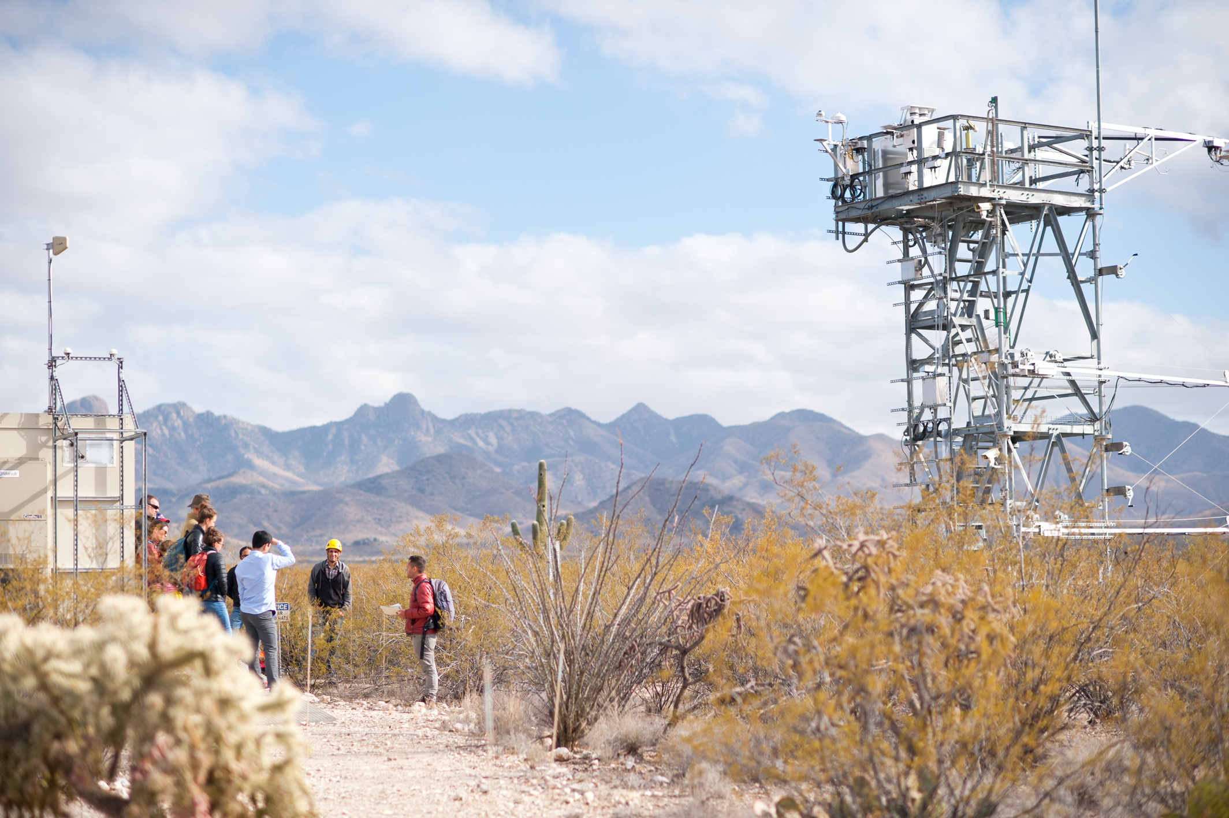
QUESTIONS?
This Webinar will be posted as presented for on-demand viewing:
Recorded Webinar –
Event webpage
NSF NEON Program Page
Email questions to the cognizant NEON Program Director: Roland P. Roberts
neon-bot@nsf.gov

